Slide 1
MPLS
(A Label Switching Protocol)

Slide 2
Introduction
MPLS stands for Multi Protocol Label Switching. It’s a Routing Protocol.
It’s layer 2.5 networking protocol
It sits between the Network Layer and Data Link Layer

Slide 3
Why MPLS
It avoids the complex routing table lookups and speeds the traffic flow.
It directs the traffic to the predetermined path in the network.
It also provides alternate network paths to avoid congestion.
Notes:
The first point is very important and that is the main reason why MPLS came into existence. MPLS was introduced for fast routing and reduce the routing table lookups. Talk about CIDR and PATRICIA trie

Slide 4
Label Switching
Traditional IP network performs an IP lookup and determines the next hop based on the routing table and forwards the packet to the next hop
MPLS instead follows Label Switching where
Instead of finding next hop, it trys to reach the final destination router.
And finds a predetermined path from the source to the final router.
Instead of forwarding packets on a hop-by-hop basis, paths are established for particular source-destination pairs. The predetermined paths that make MPLS work are called Label-Switched Paths (LSPs).

Slide 5
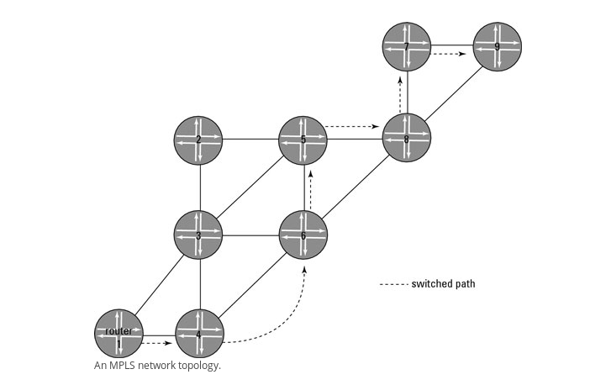
Label Switched Path
Notes:
In IP routing IP packet is forwarded to router 4 which again looks up into its routing table and performs the next hop and this continues till router 9.
In a label-switched network, a path from router 1 to router 9 is created so that all traffic from router 1 to router 9 takes the same deterministic path.
Put simply, if router 4 knows that for all traffic from router 1 to router 9, the next stop along the way is router 6, it can just forward the packets to that predetermined hop without ever looking up the route in its routing table.

Slide 6
MPLS- Basic Terminologies
MPLS Routers or Label Switched Routers
Label Edge Router (LER) or Ingress Node or Inbound Router
Transit Router
Penultimate Router
Outbound Router or Egress Node
Notes:
An LSP can contain 0 to 253 Transit Routers

Slide 7
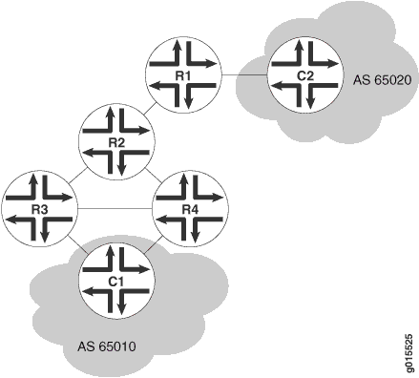
Typical LSP Topology
C1 - Customer Edge Router
R1 - Ingress Node or LER
R2 - Transit Router or also
Penultimate Router
R3,R4 - Egress Node or LER

Slide 8
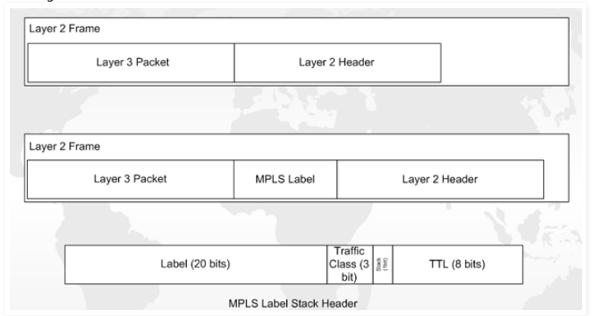
MPLS Header

Slide 9
Label Operations
PUSH: Adds a new label to the top of the packet. For IPv4 packets arriving at the inbound router, the new label is the first label in the label stack.
SWAP: Replaces the label at the top of the label stack with a new label. When a transit router receives the packet, it performs an MPLS forwarding table lookup. The lookup yields the LSP next hop and the path index of the link between the transit router and the next router in the LSP.
POP: Removes the label from the top of the label stack. For IPv4 packets arriving at the penultimate router, the entire MPLS label is removed from the label stack.

Slide 10
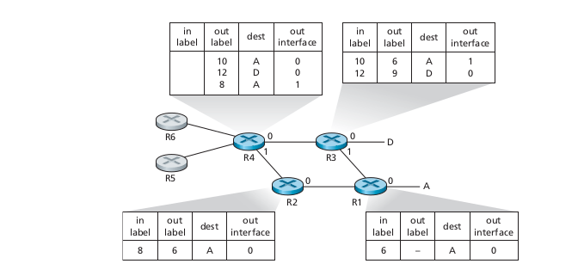
MPLS Topology with Label Distribution

Slide 11
MPLS VPN
MPLS VPN is a family of methods for using multiprotocol label switching (MPLS) to create virtual private networks (VPNs). MPLS VPN is a flexible method to transport and route several types of network traffic using an MPLS backbone.
Types of MPLS VPN
Point to Point
Layer 2 VPN (VPLS)
Layer 3 VPN (VPRS)

Slide 12

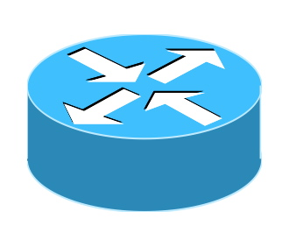
Layer 2 VPN or Virtual Private LAN Service
CE
PE
PE
CE
P
Notes:
Switch in the cloud style Service. Used by ISP
BGP and LDP based

Slide 13
Commands for MPLS
Configuration of PE and P routers
[edit interfaces]
user@host# set interface-name unit logical-unit-number family inet address ipv4_address
user@host# set lo0 unit logical-unit-number family inet address ipv4_address primary
Enable MPLS Address family on these interfaces
[edit interfaces]
user@host# set interface-name unit logical-unit-number family mpls
For CE facing L-2 VPN interfaces , enable the reception and transmission of 802.1QVLAN tagged Frames
user@host# set interfaces interface-name vlan-tagging encapsulation vlan-ccc unit logical-unit-number encapsulation vlan-ccc vlan-id vlan-id-number
Notes:
IEEE 802.1Q, often referred to as Dot1q, is the networking standard that supports virtual LANs on an IEEE 802.3 Ethernet network.

Slide 14
Set encapsulation type on PE interface that communicates with CE interface
[edit interfaces]
user@host# set interface-name encapsulation encapsulation-type
user@host# set interface-name unit logical-unit-number encapsulation encapsulation-type
Configure BGP Protocol on the CE routers to exchange information about the routes terminating at the VPN
If there are multiple PE routers, then configure OSPF or RIP to enable exchange of routing information.
To dynamically setup LSP’s LDP(Label Distribution Protocol) needs to be setup between the PE and Provider Routers.

Slide 15
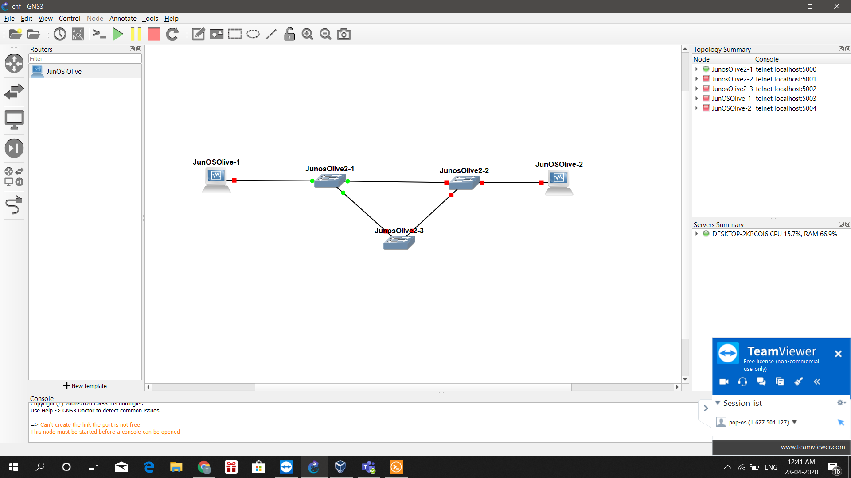

Slide 16
References
Juniper Label Switching and Label-switched Paths (LSPs)
MPLS for Dummies
https://www.juniper.net/documentation/en_US/junos/topics/topic-map/mpls-overview.html
MPLS Layer 2 VPN Configuration Overview - TechLibrary
Configuring a Routing Policy for MPLS Layer 2 VPNs (CLI Procedure) - TechLibrary

Slide 17
THANK YOU

